Slide 1
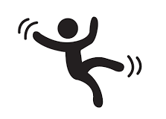
FALL DETECTION
GRADUATION PROJECT PRESENTATION
Khadija Hashad
Supervisor: Dr. Nizar Khemri

Slide 2
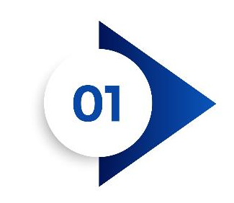



Fall Detection System
Table of Content
INTRODUCTION
METOLOGY
RESULTS
CONCLUSION
FUTURE WORK

Slide 3
RESULTS
INTRODUCTION

Slide 4
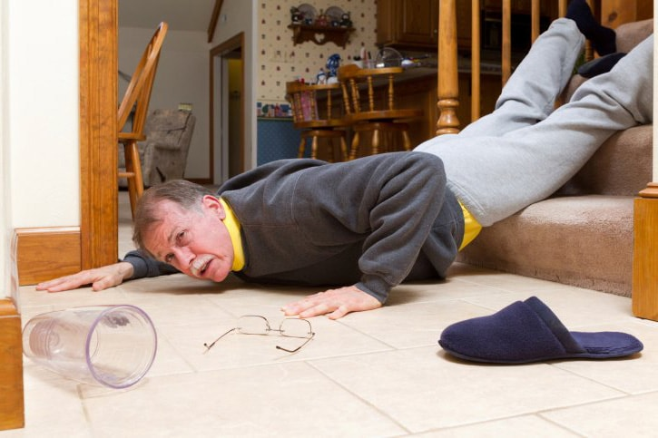
Fall Detection System
Introduction
Fall-related injuries are more common among older persons and are a major cause of pain, disability, loss of independence and premature death.
Older people are the most vulnerable, as they often have chronic diseases that require continuous medical assistance. Any person living alone is at a higher risk of not getting medical care in due time, and special attention must be given to people above 65.
According to the World Health Organization, in 2018, it was reported for the first time in history that the number of people over 65 exceeded the number of people under 5 years of age worldwide. Therefore, it is estimated that by 2050, one in six people will belong to the elderly sector.
Recently, the World Health Organization (WHO) reported that there are approximately 684,000 disastrous falls worldwide each year, with a majority of victims being individuals over the age of 60. This large percentage places it behind road traffic injuries as the leading cause of unintentional injury fatality.
Notes:
Falls of the elderly always lead to serious health issues as the decline of their physical fitness.
Fracture is the most common injury in fall of an elderly and there is also a certain possibility to get coma, brain trauma, and paralysis.
At most fall situations, the fall process is the main source of injury because of the high impact. But sometimes the late medical salvage may worsen the situation. That means the faster the salvage comes, the less risk the elderly will face.

Slide 5
Fall Detection System
Introduction
Fall detection is necessary for control over adults with health issues like:
Parkinson's disease: People with Parkinson's disease have a higher risk of falls due to their impaired balance and coordination.
Osteoporosis: This condition weakens bones, making them more susceptible to fractures from falls.
Stroke: After a stroke, individuals may experience weakness or paralysis on one side of their body, which can increase the likelihood of falls.
Dementia: People with dementia may have difficulty with spatial awareness and memory, leading to falls.
Cardiovascular disease: Heart conditions can cause dizziness or fainting spells, increasing the risk of falls.
Diabetes: Diabetic neuropathy can cause numbness or tingling in the feet, leading to balance issues and falls.
Multiple sclerosis: This condition can cause muscle weakness and spasticity, making it difficult to maintain balance and increasing the risk of falls.
Notes:
Falls of the elderly always lead to serious health issues as the decline of their physical fitness.
Fracture is the most common injury in fall of an elderly and there is also a certain possibility to get coma, brain trauma, and paralysis.
At most fall situations, the fall process is the main source of injury because of the high impact. But sometimes the late medical salvage may worsen the situation. That means the faster the salvage comes, the less risk the elderly will face.

Slide 6

Fall Detection System
Introduction
Falls are the second leading cause of unintentional injury deaths worldwide, according to the World Health Organization.
Individuals with impaired vision, deafness, living alone, and other medical conditions are particularly vulnerable to fall-related injuries and death.
Unfortunately, the rate of deaths caused by falls continues to increase each year, and if this growth continues, it is anticipated that by 2030, there will be 7 fatalities every hour.
Emergencies can occur without recognition and even without warning. That is why fall detection technology in medical warning systems is such a critical and life-saving feature. If, for any reason, they were not able to reach the assistance button after a fall (or in a medical emergency), a medical alert system’s automated fall detection feature could give you a peace of mind that you would still get the care you need.
Fall detection technology can help caregivers monitor these individuals and provide timely assistance in case of a fall, reducing the risk of injury and improving overall quality of life.
Notes:
Older people are the most vulnerable, as they often have chronic diseases that require continuous medical assistance. Any person living alone is at a higher risk of not getting medical care in due time, and special attention must be given to people above 65.
Fall detection is necessary for control over adults with health
issues like:
Parkinson's disease: People with Parkinson's disease have a higher risk of falls due to their impaired balance and coordination.
Osteoporosis: This condition weakens bones, making them more susceptible to fractures from falls.
Stroke: After a stroke, individuals may experience weakness or paralysis on one side of their body, which can increase the likelihood of falls.
Dementia: People with dementia may have difficulty with spatial awareness and memory, leading to falls.
Cardiovascular disease: Heart conditions can cause dizziness or fainting spells, increasing the risk of falls.
Diabetes: Diabetic neuropathy can cause numbness or tingling in the feet, leading to balance issues and falls.
Multiple sclerosis: This condition can cause muscle weakness and spasticity, making it difficult to maintain balance and increasing the risk of falls.
Fall detection technology can help caregivers monitor these individuals and provide timely assistance in case of a fall, reducing the risk of injury and improving overall quality of life.

Slide 7

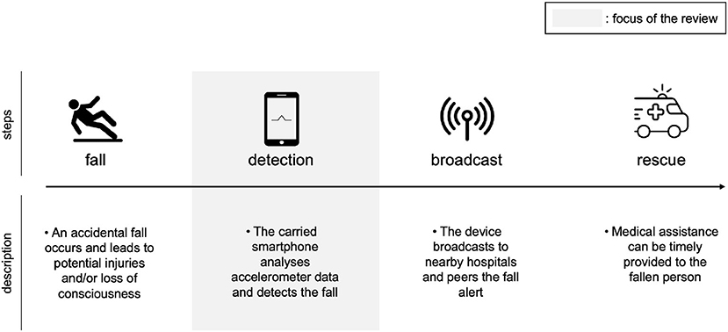
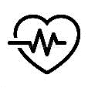

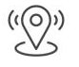
Fall Detection System
Our Goals
The proposed system work as an alert system once a fall occurs.
Our system uses sensors to detect falls and heart rate with the help of GPS and GSM modules to obtain the exact location where the fall occurred, which can be sent to the emergency center or police.
The main effect of this work is to reduce the waiting time for fall victims to receive medical assistance.
Through this implementation, we can detect the condition of the person who fell so that we can provide first aid as soon as possible.

Slide 8
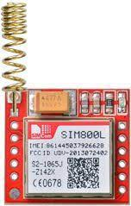
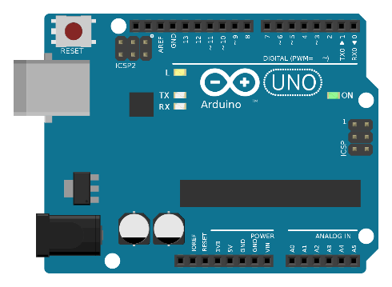
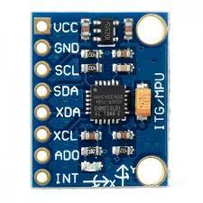
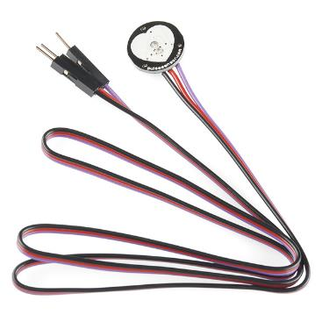
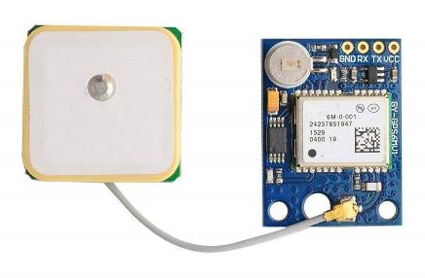
Hardware Components
System Overview
Arduino Uno R3
MPU 6050 Sensor
GSM SIM 800L
GPS neo6m Module
Pulse sensor

Slide 9
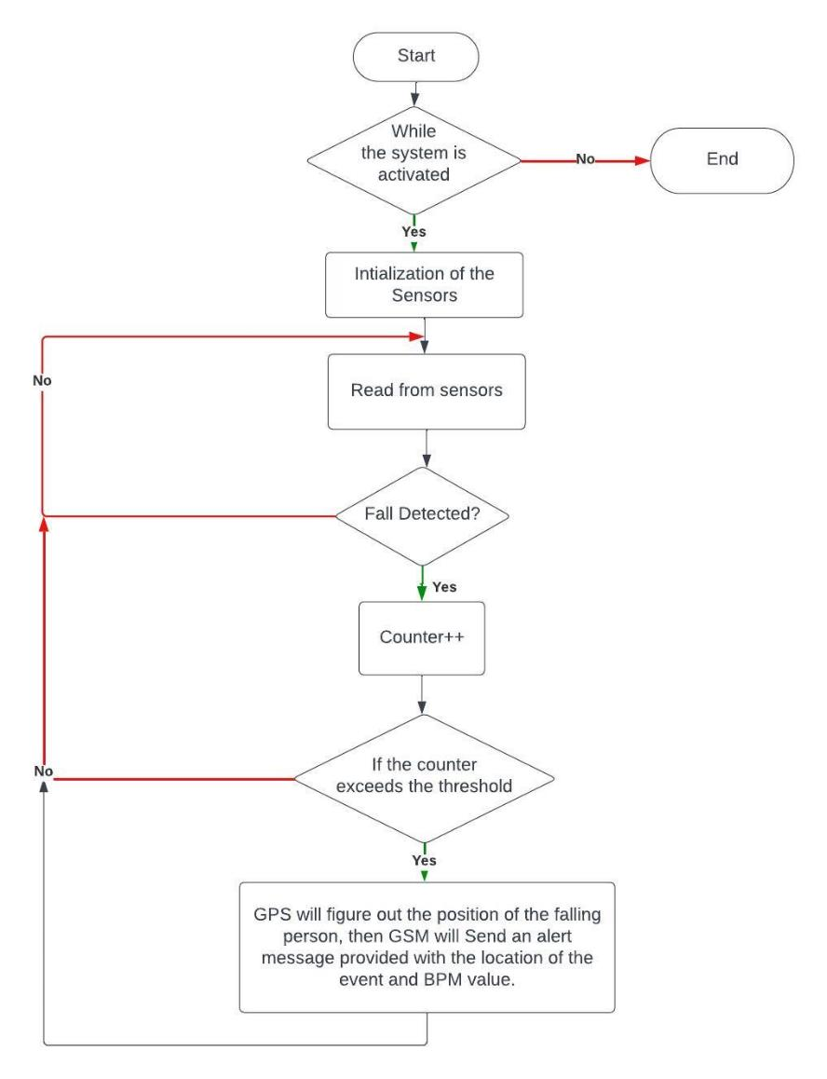
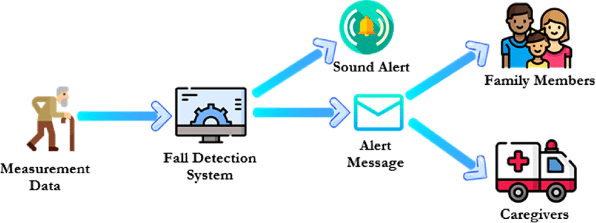
Flow Chart
System Overview

Slide 10
Fall Detection System
Budget
Component | Store | Cost (LYD)
Arduino uno R3 | القدرة الرقمية | 45
MPU6050 | القدرة الرقمية | 15
Pulse sensor | القدرة الرقمية | 25
GSM SIM800L | Asas Company | 50
GPS neo6m | القدرة الرقمية | 50
Total | - | 185

Slide 11
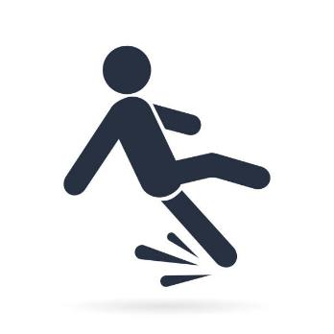
THANK YOU

